Slide 1

MISHA RIAZ
17th MAY, 2024
Hotel Reservation Analysis
The hotel industry relies on data to make informed decisions and provide a better guest experience.

Slide 2

MISHA RIAZ
17th MAY, 2024
Problem Statement
The hotel industry faces the challenge of effectively leveraging data to enhance decision-making processes and elevate guest experiences. The objective of this analysis is to harness insights from a hotel reservation dataset to understand guest preferences, discern booking patterns, and identify pivotal factors influencing operational dynamics.

Slide 3

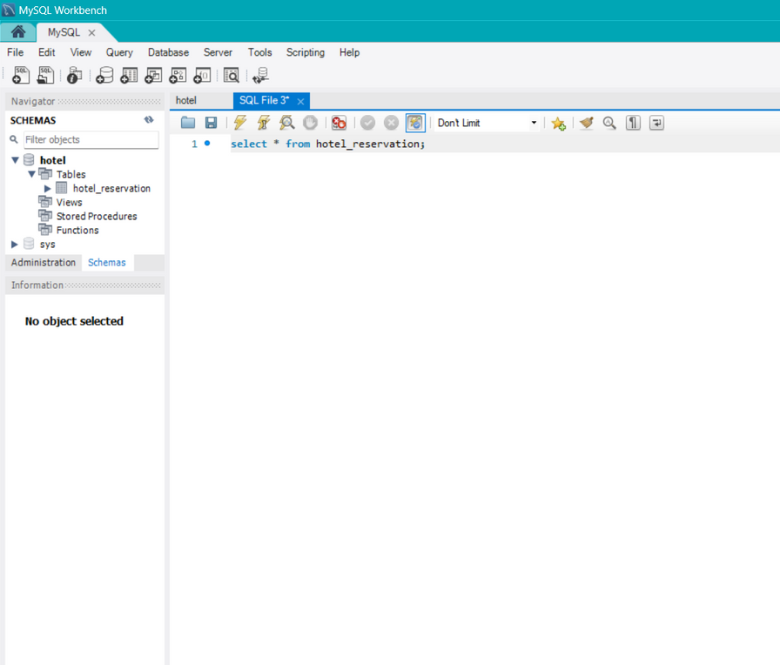
MISHA RIAZ
17th MAY, 2024
MySQL
Analysis Agenda
In this analysis, I worked with a hotel reservation dataset to gain insights into guest preferences, booking trends, and other key factors that impact the hotel's operations. I used SQL to query and analyze the data, as well as answer specific questions about the dataset.

Slide 4
MISHA RIAZ
17th MAY, 2024
CONTENT
1
Problem Statement
3
Data Details
2
4
Key Findings
Analysis Agenda

Slide 5

MISHA RIAZ
17th MAY, 2024
Dataset Details
Booking_ID: A unique identifier for each hotel reservation.
no_of_adults: The number of adults in the reservation.
no_of_children: The number of children in the reservation.
no_of_weekend_nights: The number of nights in the reservation that fall on weekends.
no_of_week_nights: The number of nights in the reservation that fall on weekdays.
type_of_meal_plan: The meal plan chosen by the guests.
room_type_reserved: The type of room reserved by the guests.
lead_time: The number of days between booking and arrival.
arrival_date: The date of arrival.
market_segment_type: The market segment to which the reservation belongs.
avg_price_per_room: The average price per room in the reservation.
booking_status: The status of the booking.

Slide 6



MISHA RIAZ
17th MAY, 2024
Key Findings
No. of Reservations
700
What is the total number of reservations in the dataset?
The dataset comprises a total of 700 reservations, providing a comprehensive view of the hotel's booking activities over the specified period.

Slide 7


MISHA RIAZ
17th MAY, 2024
Key Findings
Popular Meal Plan
Meal Plan 1
Which meal plan is the most popular among guests?
Meal Plan 1 emerges as the most preferred option among guests based on the analysis of the dataset. This finding sheds light on guest preferences and provides valuable insights for catering and menu planning strategies.

Slide 8


MISHA RIAZ
17th MAY, 2024
Key Findings
Avg. Price per room with kids
145
What is the average price per room for reservations involving children?
Reservations involving children exhibit an average room price of 145, highlighting the pricing dynamics for this segment of guests. Understanding the pricing preferences of families we can inform promotional strategies and pricing adjustments to optimize revenue and guest satisfaction.

Slide 9
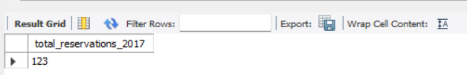
MISHA RIAZ
17th MAY, 2024
Key Findings
No. of Reseravtion in 2017
123
How many reservations were made for the year 2017?
In 2017, the hotel recorded a total of 123 reservations, contributing to the overall dataset. This insight provides context regarding booking trends over different time periods.

Slide 10


MISHA RIAZ
17th MAY, 2024
Key Findings
Most Booked Room Type
Room Type 1
What is the most commonly booked room type?
Room Type 1 is the most frequently booked option, with a total count of 534 reservations. This finding highlights the popularity of this room type among guests

Slide 11



MISHA RIAZ
17th MAY, 2024
Key Findings
Reservations on Weekend
383
How many reservations fall on a weekend?
Out of the total reservations, 383 fall on weekends, indicating a significant portion of bookings occurring during weekends. This insight into booking patterns can inform staffing and resource allocation decisions to ensure optimal guest experiences during peak periods.

Slide 12


MISHA RIAZ
17th MAY, 2024
Key Findings
Lead Time
443
What is the highest and lowest lead time for reservations?
The highest lead time recorded for a reservation is 443 days, indicating bookings made well in advance, while the lowest lead time is 0 days, suggesting last-minute bookings. Understanding lead time dynamics can help optimize revenue management and resource allocation strategies.

Slide 13


MISHA RIAZ
17th MAY, 2024
Key Findings
Popular Market Segment
Online
What is the most common market segment type for reservations?
The online market segment is the most prevalent category, with a total count of 518 reservations. This insight underscores the importance of online channels in driving bookings and highlights the need for targeted marketing and distribution strategies in the digital space.

Slide 14


MISHA RIAZ
17th MAY, 2024
Key Findings
No. Confirmed Bookings
493
How many reservations have a booking status of "Confirmed"?
Out of the total 700 reservations, 493 have a booking status of "Confirmed," indicating a high confirmation rate for bookings. This substantial number of confirmed reservations highlights the reliability and appeal of the hotel to its guests.

Slide 15


MISHA RIAZ
17th MAY, 2024
Key Findings
No. of Adults and Children
1316 Adults 69 Children
What is the total number of adults and children across all reservations?
The dataset reveals a total of 1,316 adults and 69 children across all reservations. This indicates that the majority of the hotel’s guests are adults, with a relatively small number of children accompanying them.

Slide 16


MISHA RIAZ
17th MAY, 2024
Key Findings
Avg. No. of Weekend Nights
1
What is the average number of weekend nights for reservations involving children?
The analysis shows that for reservations involving children, the average number of weekend nights is 1. This suggests that families typically book stays that include at least one weekend night, reflecting a preference for weekend getaways or short vacations.

Slide 17
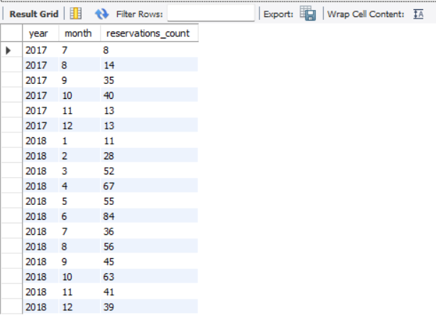
MISHA RIAZ
17th MAY, 2024
Key Findings
Reservations Each Month
How many reservations were made in each month of the year?
The following visual shows the number of reservations for each month of the year. The analysis reveals that the 6th month of 2018 has the highest number of reservations, totaling 84, while the 7th month of 2017 shows the lowest number of reservations, with only 7.

Slide 18
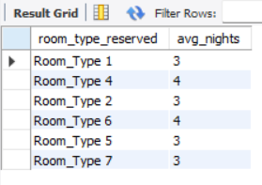
MISHA RIAZ
17th MAY, 2024
Key Findings
Avg no. of Nights by Room Type
What is the average number of nights (both weekend and weekday) spent by guests for each room type?
The following visual illustrates the average number of nights spent by guests for each room type. According to the analysis, room type 4 and room type 6 exhibit the highest average number of nights.

Slide 19




MISHA RIAZ
17th MAY, 2024
Key Findings
Common Room Type with Kids
Room type 1
For reservations involving children, what is the most common room type, and what is the average price for that room type?
For reservations involving children, the most common room type is Room Type 1, with a count of 24 reservations. The avg. price for Room Type 1 is 123. This finding suggests that Room Type 1 is preferred by families, indicating its suitability for accommodating children.

Slide 20

MISHA RIAZ
17th MAY, 2024
Key Findings
Market Segment Type
Online
Find the market segment type that generates the highest average price per room.
The market segment type that generates the highest average price per room is "Online," with an average price of 112.
This insight highlights the significance of online channels in attracting guests who are willing to pay higher prices for accommodations.

Slide 21
MISHA RIAZ
17th MAY, 2024
Thank you!
Have
a good weekend!

